Slide 1

Assessing the Marketing Environment
Having a reason for decisions….in other words, is the timing right?

Slide 2
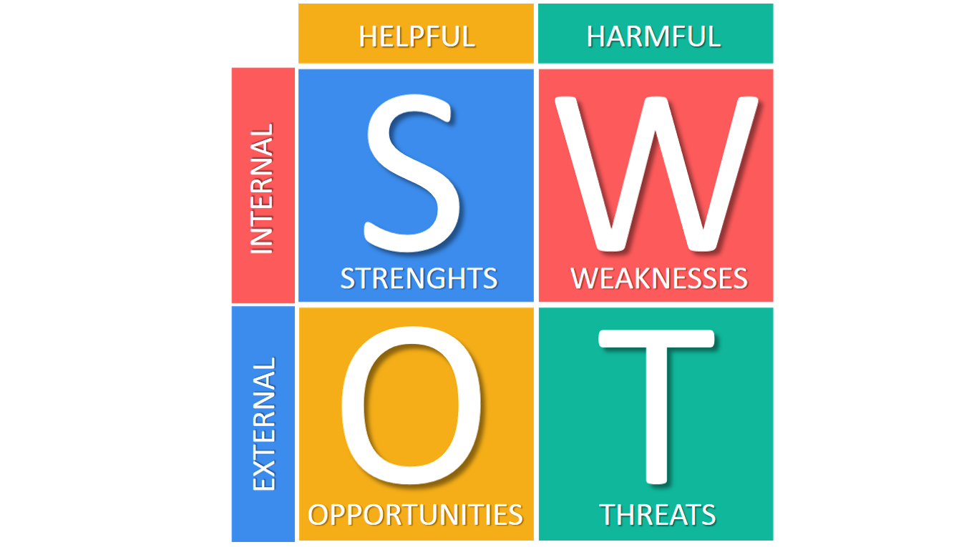
STRENGTHS /
WEAKNESSES
OPPORTUNITIES /
THREATS
Internal
Controllable
External
Uncontrollable

Slide 3
WHY?
Is it a good fit for us?
Is the timing right?
Will it last or is it short-term? We are looking for a match between ‘opportunity’ and ‘strength’
  If it’s a long-term match, it is called a market opportunity
  If it’s a short-term, or cyclical, match, it is called a strategic window
The SWOT is a fluid document

Slide 4


The Process
Strengths and Weaknesses
  Self-assessment
  Brave enough for outside input?
Opportunities and Threats
  Environmental Scanning
  Environmental Analysis

Slide 5
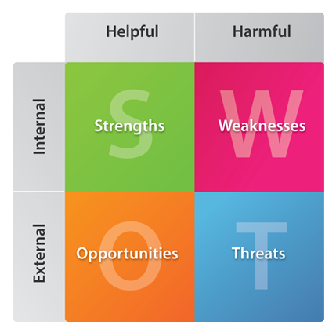
The Output
Environmental Scanning
  Identification of trends (not nouns)
Environmental Analysis
  Which trends could possibly impact your decision making? Identifying Opportunities and Threats: external and uncontrollable
SWOT Analysis
  Outline the organization’s Strengths and Weakness (internal and controllable) and the Opportunities and Threats determined in the environmental analysis
  Typically presented in a graphic format

Slide 6
Is it an Opportunity, a Threat, neither or both?
Demographics
  Age / Gender / Education / Ethnicity
  Income
    Consumer Buying Power
      Income Distribution
    Disposable Income
    Discretionary Income
Technology
  Combined with Research
  Impact on Customer Value
  Infrastructure
Social / Cultural
  “Green Marketing”
  Time Poverty
  Privacy Issues
  Regional / International / Definition
Economic
  Macroeconomic Cycle
    Prosperity
    Recession
    Deflation
    Recovery
  Interest Rates

Slide 7
Is it an Opportunity, a Threat, neither or both? (cont.)
Competitive
  Competitive intelligence
  Industry Analysis
  Direct vs. Indirect
Political / Legal
  Regulatory Agencies
    FTC, FCC, FDA, NARB
  Consumer Bill of Rights
    The Right to Choose
    The Right to Safety
    The Right to be Heard
    The Right to be Informed
  Trade / Tariffs
  Regulations

